Slide 1


Team 37: Microhistological Analysis of the Dietary Habits of Sheep
Godson Edewor, Arnav Gokhale, Jack Nelson, and Nate Scott TA: Sabyasachi Gupta Sponsor: John Lusher

Slide 2
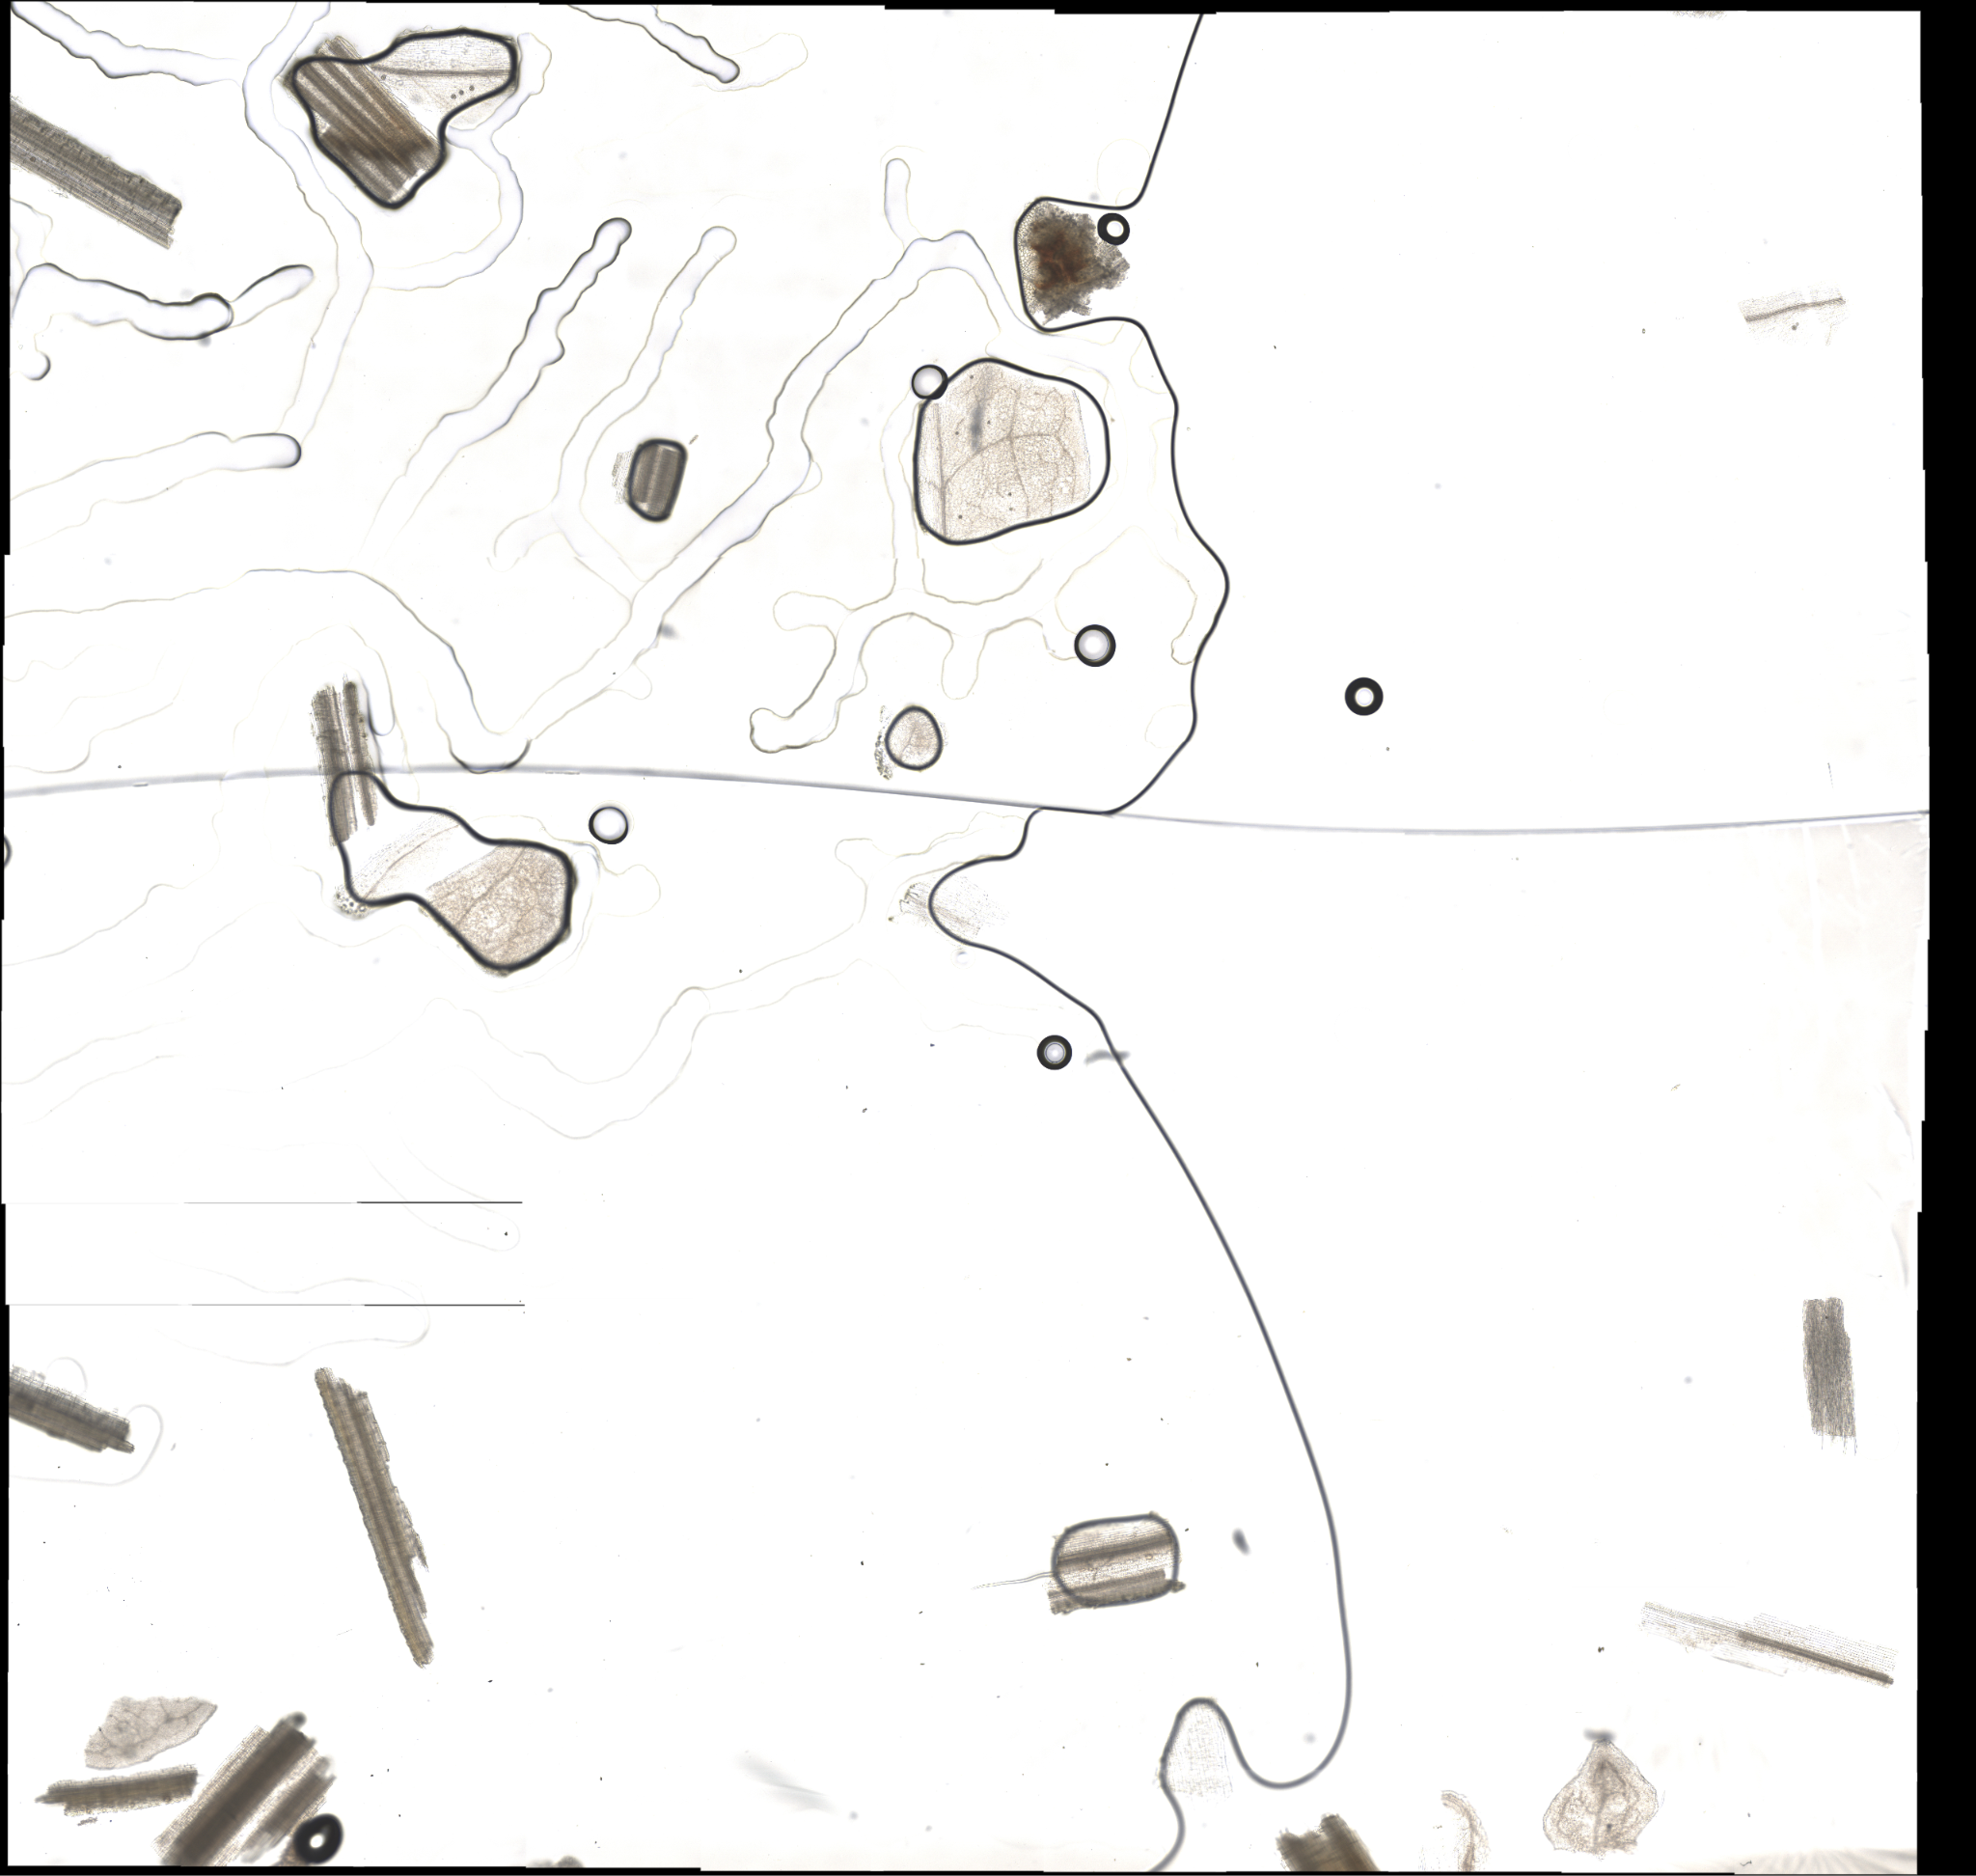
Problem Overview
Problem Statement:
TAMU AgriLife is currently investigating the Dietary Habits of Sheep and the effect it has on their wool.
This can be a very time consuming effort, when analyzing microscopic samples by hand.
Solution Proposal:
GrazeView AI will allow the process of analyzing these microscope slides to become automated.
This will save TAMU AgriLife both time and money spent in training individuals that analyze by hand.

Slide 3
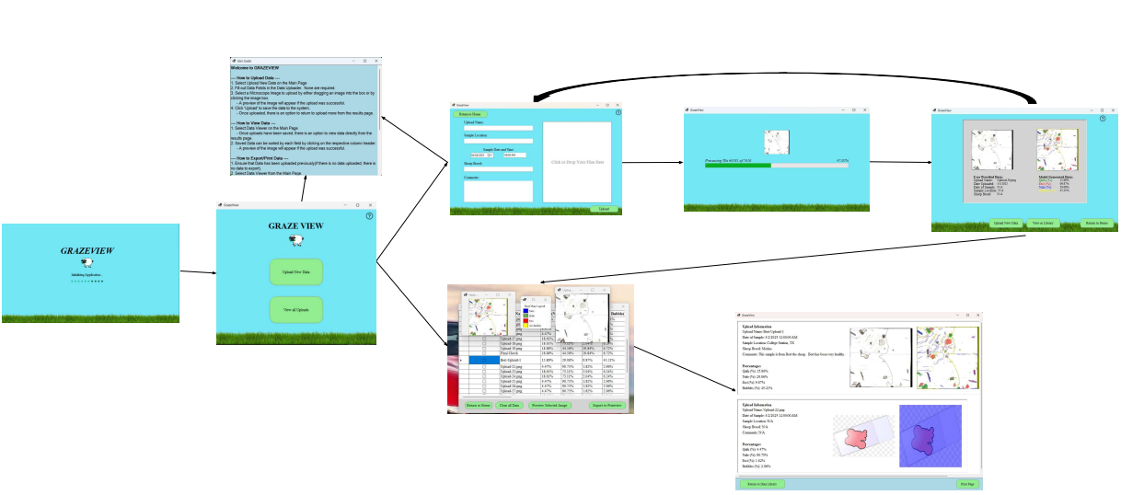
Integrated Project Diagram

Slide 4
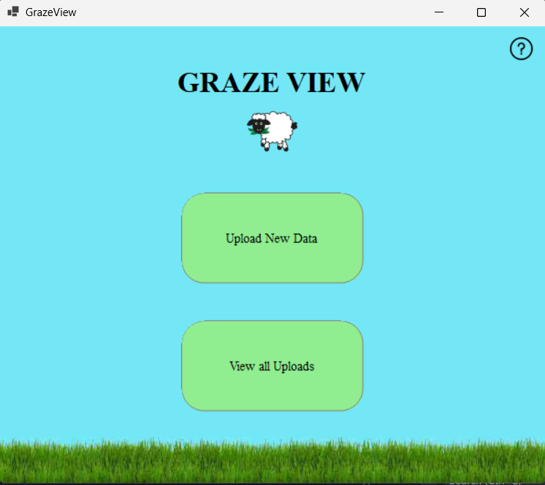
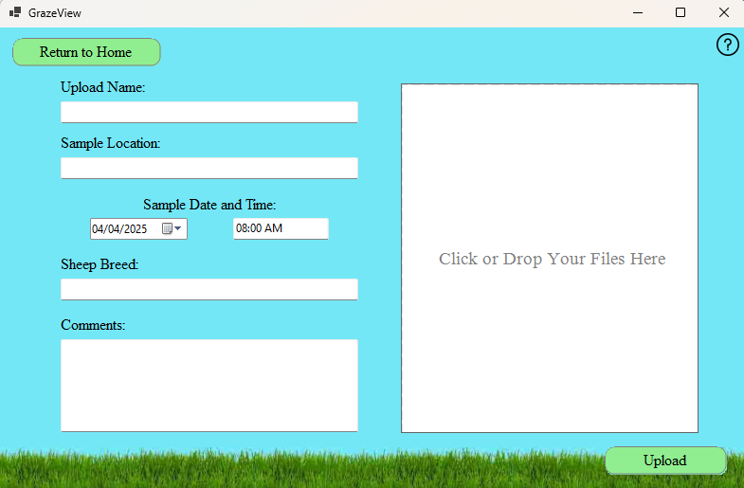
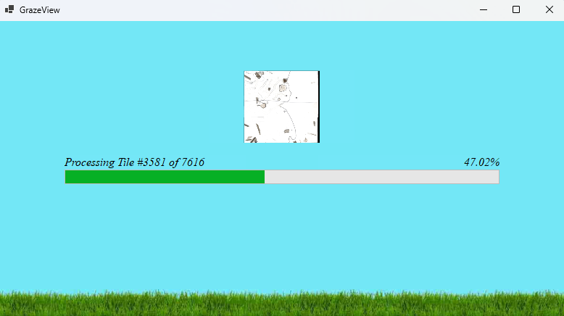
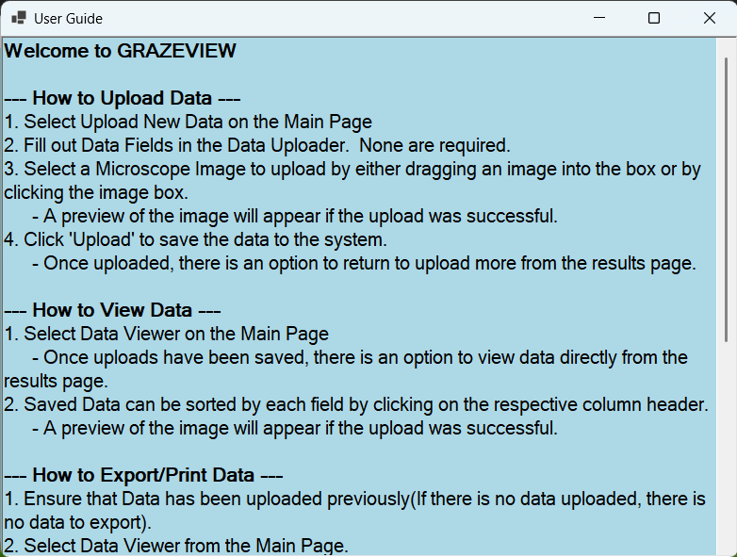
UI Visual Design - Overview
Nate Scott
Specifications
Designed a visually clean and intuitive interface across all pages
Incorporated a consistent theme and background design throughout the application
Applied uniform button styling, layout spacing, and font choices
Included dynamic and engaging visual elements to enhance user experience
Designed visual hierarchy to support intuitive user flow and page navigation
Maintained a balance between playful design and professional functionality

Slide 5
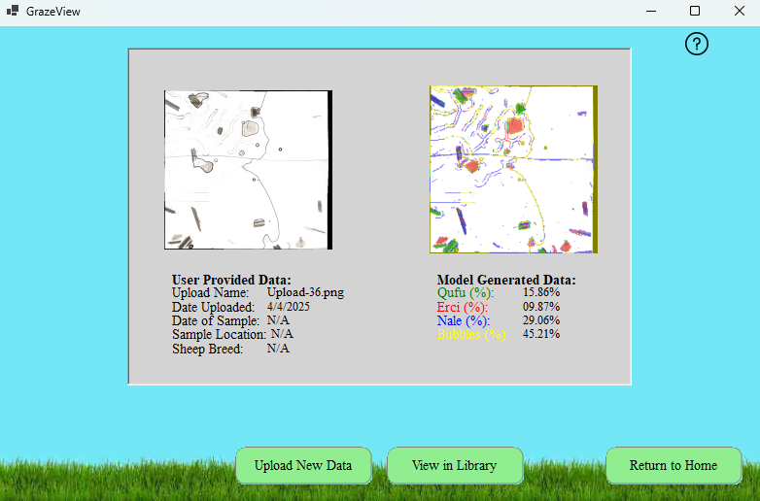
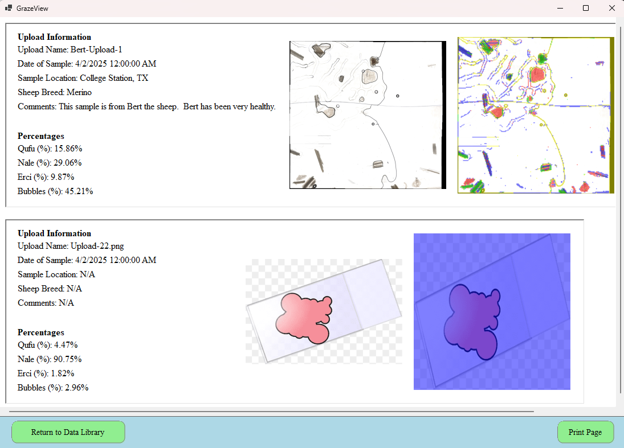
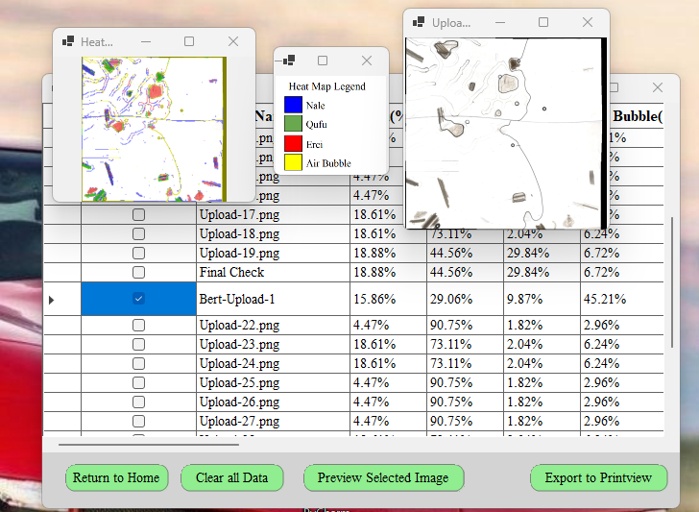
UI Visual Design - Challenges/Solutions
Nate Scott
Challenges
Ensure consistent visual layout and spacing across all pages and components
During and after integration
Handle DPI scaling and resolution differences in machines
Embed any external images and visual assets within the executable build
Create a balance between playful elements and professional tone
Solutions
Performed multiple tests that confirmed that layout consistency, styling, and visual elements were preserved across all pages
Applied DPI scaling-aware layout with consistent anchoring and relative sizing
Reference any resources programmatically upon deployment of the application
Removed visual elements on data-intensive pages

Slide 6
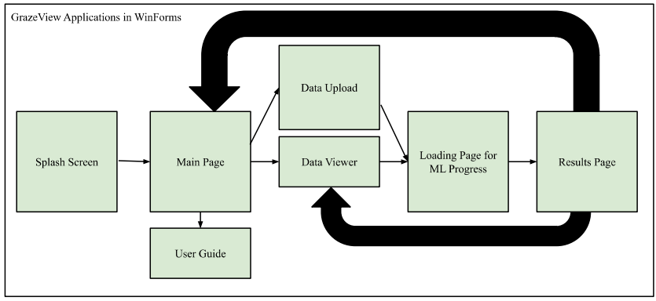
UI Function - Overview
Jack Nelson
Specifications
Allow users to upload images with associated data
Allow users to view all uploads in the Data Library
Provide Previews of each upload
Provide a print layout for multiple selected uploads
Provide real time updates via the Loading Page
Provide all ML generated results via Results Page

Slide 7
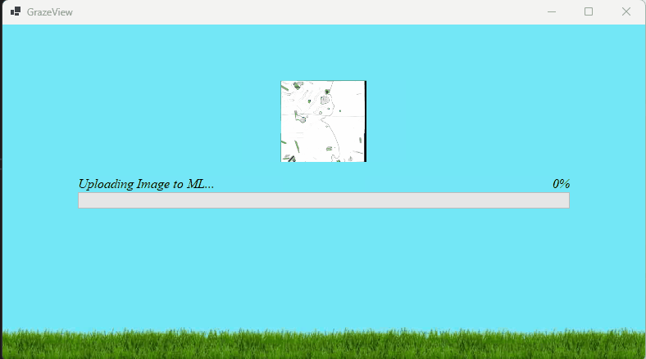
UI Function - Challenges/Solutions
Jack Nelson
Challenges
Resize events causing visible lag
Initial thread management causing lag after integration
ML Processes freeze the UI
Improper Indexing between the UI and Database
Solutions
Change dynamically determined resizing with anchors and panels
Offload ML Processes and large image passing to prevent UI freezes
Utilized Global list “GlobalData” to push all upload info at once, rather than in increments

Slide 8
Database Overview
Arnav Gokhale
Efficiently store, retrieve, and manage all ML analysis results, as well as associated image data
SQL-based relational database, deployed on cloud infrastructure (Azure Microsoft SQL)
Tested against identical datasets in different environments to ensure reliability, robustness and compatibility

Slide 9
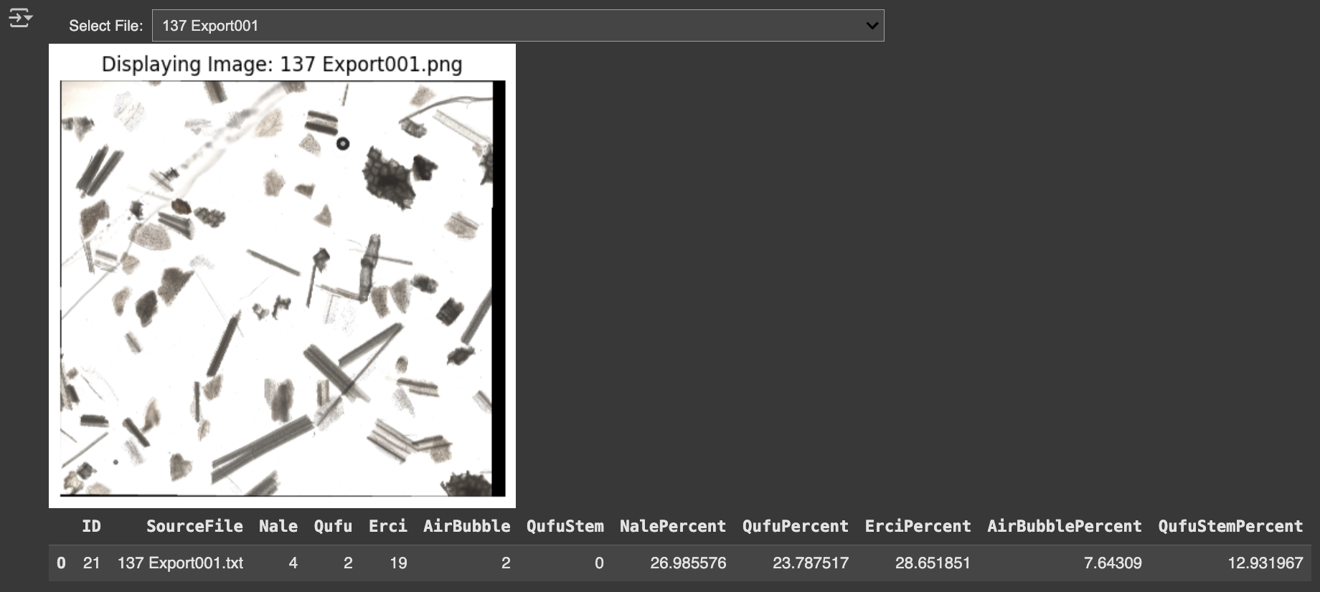
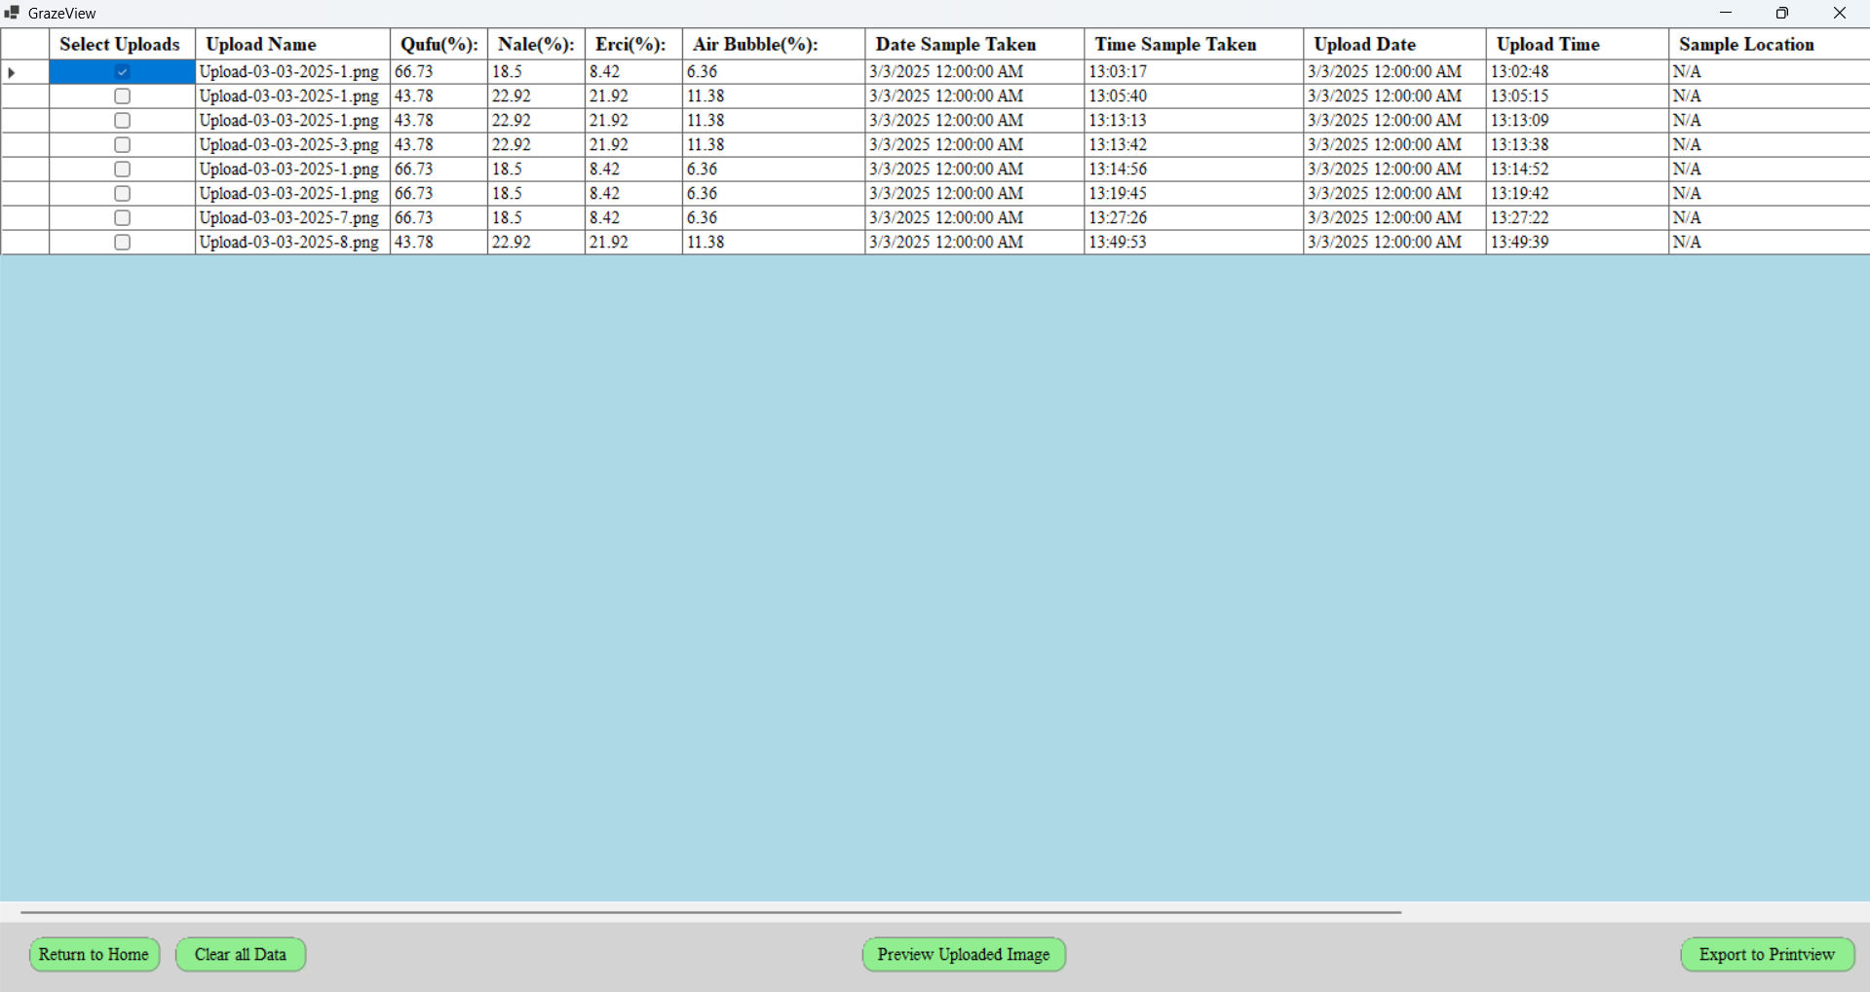
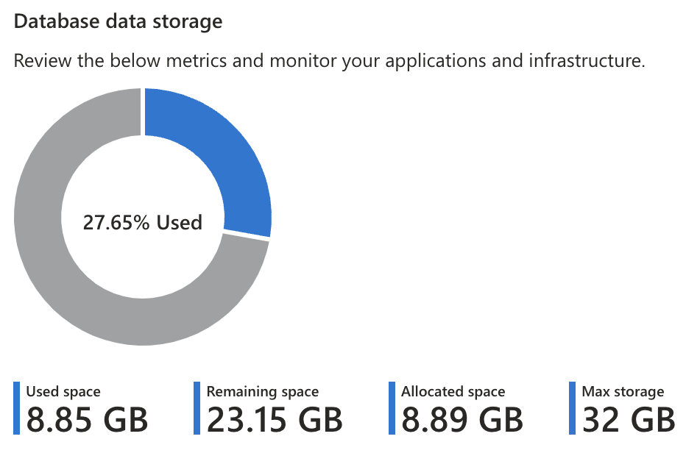
Database Challenges & Solutions
Arnav Gokhale
Challenges
Sync Pull Request
Timing out Errors
Dropping connections
Solutions
Better table management
Increase time_out, compression, implementing driver
Auto-Pause Delay, connection string runs multiple times on button

Slide 10
Machine Learning Accomplishments
Godson Edewor
Validated +90% Accurate ML Solution
Implemented InceptionV3 Backbone + CNN Head Transfer Learning Style
Created One to One Heat Map output from ML Inference

Slide 11
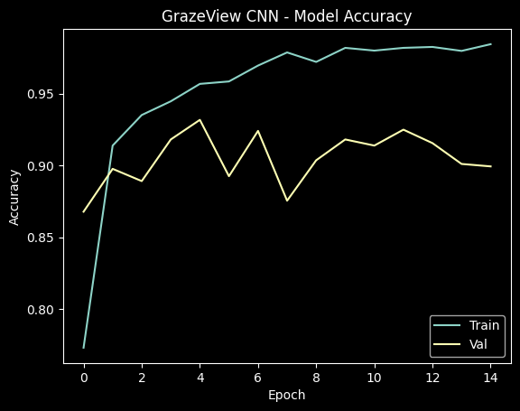
Machine Learning Accomplishments
Godson Edewor
Challenges
80% accuracy plateau
Finding the best app host for trained model
Backfilling the heatmap for whitespaces
Solutions
Implemented InceptionV3 backbone to enhance model
Used ONNX to convert weights for .NET applications
Implemented checking math to track whitespaces

Slide 12
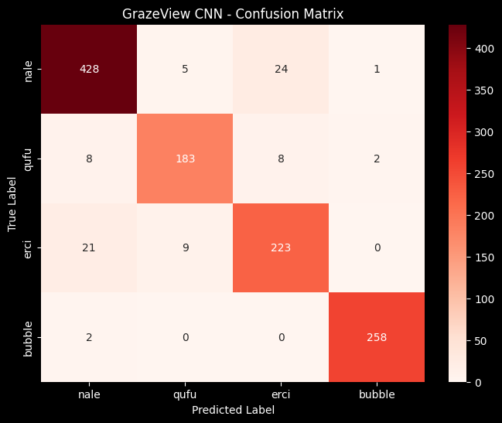
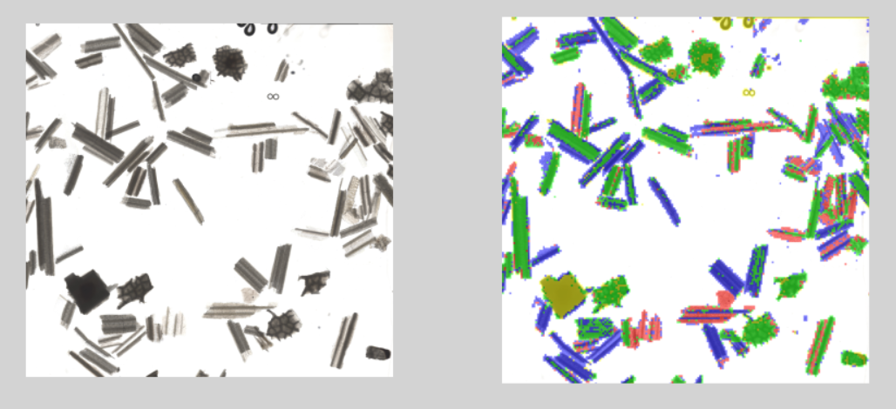
Machine Learning Accomplishments
Godson Edewor

Slide 13
Integrated System Results
Item | Spec | Minimum | Average | Maximum
Image Upload Time | <20 seconds | 9.95 s | 13.67 s | 15.92 s
ML Process Time | <3 minutes | 1:16 min | 1:43 min | 2:14 min
Application Load Time | <10 seconds | 0.71 s | 1.83 s | 18.64 s
Database Pass Time | <10 seconds | 2.55 s | 4.31 s | 6.19 s
Item | Met
No Runtime Errors | Yes
Device Requirements (>8GB of RAM and Disk Space, Modern Multi-Processor) | Yes
Seamless Resizing | Yes
Application can be installed | Yes

Slide 14
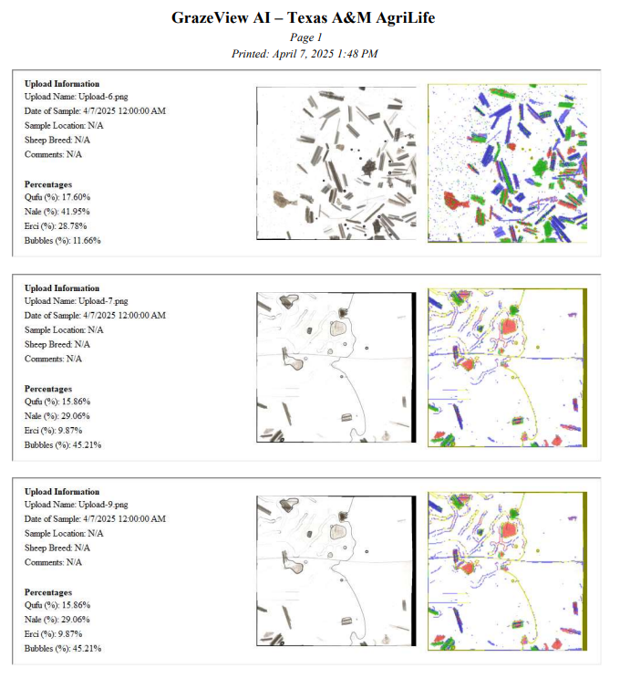
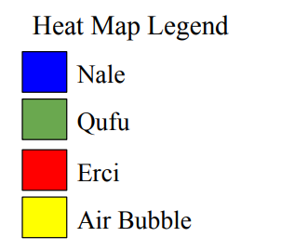
Integrated System Results

Slide 15
Conclusions
We had no functional changes from our CONOPs design
All system flows, ML analysis, and Database storage were implemented and validated as planned
Current Status: All Integration and Validation complete, currently testing until Demo

